Slide 1
Fast food delivery
LOVELY MAE P. SERVIDOR
YOMAR IWAY
LYRE DIAMOND ABAQUITA
HENDRIC ANDRE ENCONTRO
Grade 12-IC4AA (ICT)

Slide 2
FUNCTIONALITIES:
Allows you to order in your choice
Modify food categories
Customer/s can also view name and price of the product

Slide 3
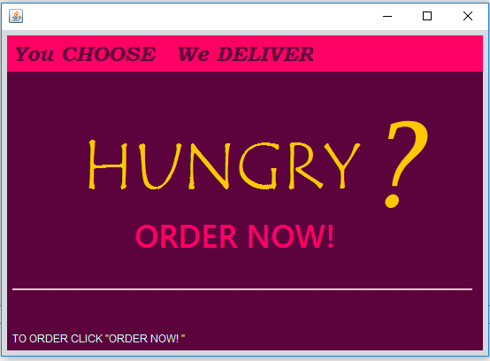

Slide 4
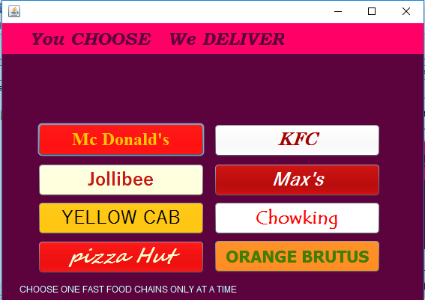

Slide 5
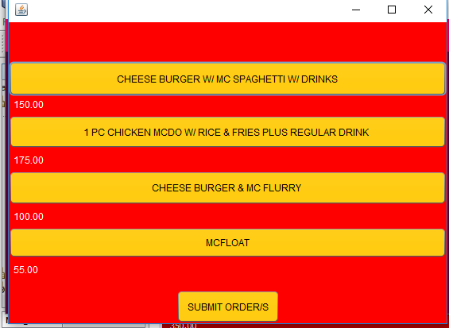

Slide 6
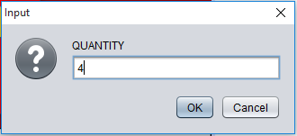

Slide 7
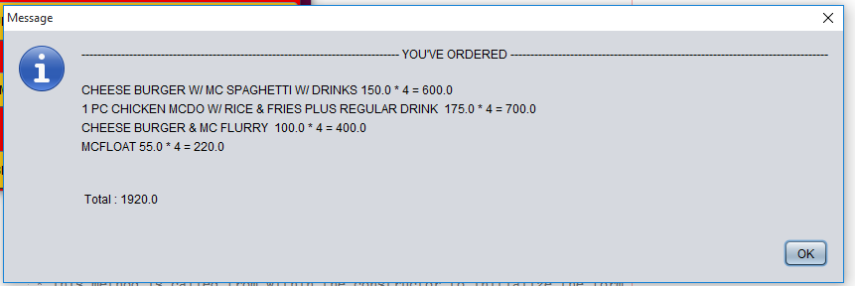

Slide 8
